Slide 1
Customer Churn Analysis of
Southeast Airlines
Group 5

Slide 2
Agenda
Overview
NPS
Data Exploration
Data Modeling
Insight

Slide 3
Overview
Our goal is reduce customer churn for Southeast Airlines and its regional partners
Avoid the loss of customers, instead of minimizing loss
Shift in focus from “Loyalty” to “Net Promoter Score”
Identify some critical metrics for our evaluation
Notes:
Customer churn is actually a lagging indicator, meaning the loss has already occurred. As such, it was a measurement of the damage inflicted. The real goal is to reduce churn by getting ahead of the loss (of the customer) by identifying some leading indicators, or metrics, that might help keep a customer. In other words, these leading indicators, or metrics, could help identify when a customer was about to stop flying Southeast. These insights could provide actionable suggestions as to how to avoid having the customers leave and go to another airline.In thinking about customer churn, several key facts are relevant

Slide 4
Dataset Overview
Thousands of customers are surveyed
Data is collected for several flying related variables, such as:
Origin city, Travel Type, Class, Flight Distance, Departure Delay
And customer specific variables:
Age, Gender, Price Sensitivity, Shopping expenditure at airport
Our dataset has responses from over 10,000 customers for 28 such variables
Includes customer from Southeast Airlines, and 14 regional partners

Slide 5


Net Promoter Score (NPS)
We ask the customers: “How likely are you to recommend our airline to friends or family ?”
Detractors Passive Promoters
Calculate:

Slide 6
NPS for each partner airline
OnlyJets Airlines Inc. : 12.50
FlyFast Airways Inc. : -19.26
Paul Smith Airlines Inc. : 17.07
FlyHere Airways : 14.34
Cool & Young Airlines Inc. : 28.84
Going North Airlines Inc. : -11.11
West Airways Inc. : 46.15
Southeast Airlines Co. : 11.98
Oursin Airlines Inc. : 0.31
Northwest Business Airlines Inc.: -57.90
Cheapseat Airlines Inc. : 2.02
FlyToSun Airlines Inc. : 19.28
Sigma Airlines Inc. : 16.10
Enjoy Flying Air Services: 10.80

Slide 7
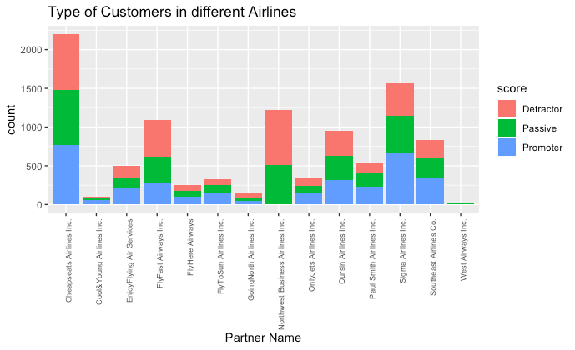
Types of Customers

Slide 8
Data Exploration
2

Slide 9
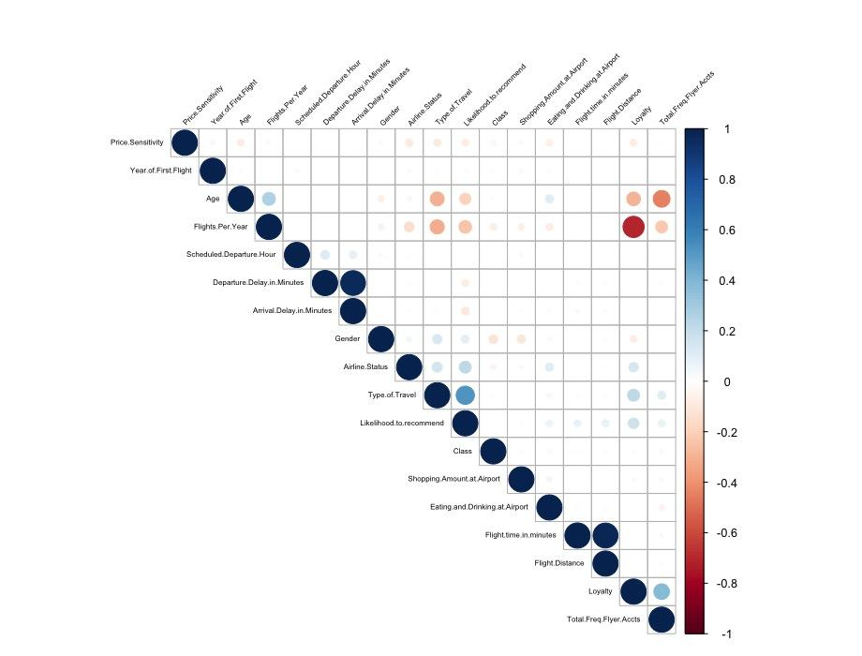
Correlation
Attributes influencing Likelihood to Recommend:
Price Sensitivity
Age
Flights Per Year
Departure Delay in Minutes
Arrival Delay in Minutes
Gender
Airline Status
Type of Travel
Eating and Drinking Amount at Airport
Flight Time in Minutes
Flight Distance
Loyalty
Total Freq Flyer Accounts
Notes:
The second part of the project is Data exploration.
First We generated a correlation plot to get an idea about significant variables which are likely to influence the Likelihood to recommend value of the Airlines. From the plot, we have a total of 13 variables. The first 5 variables have a negative effect on likelihood to recommend and rest have a positive effect.
My friend will explain them in detail.

Slide 10
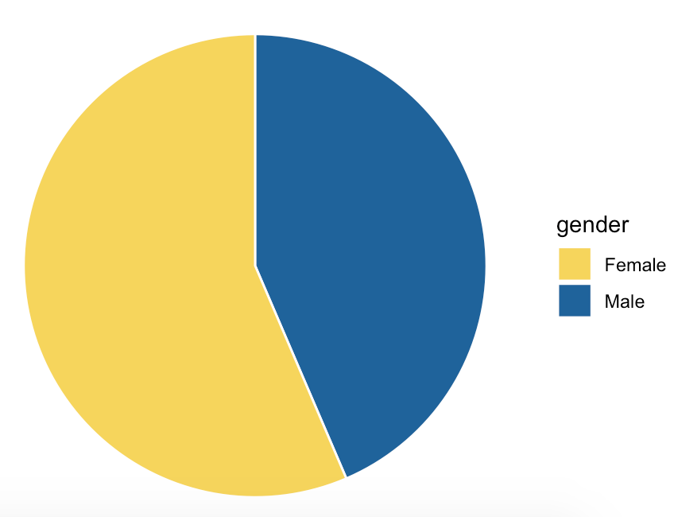
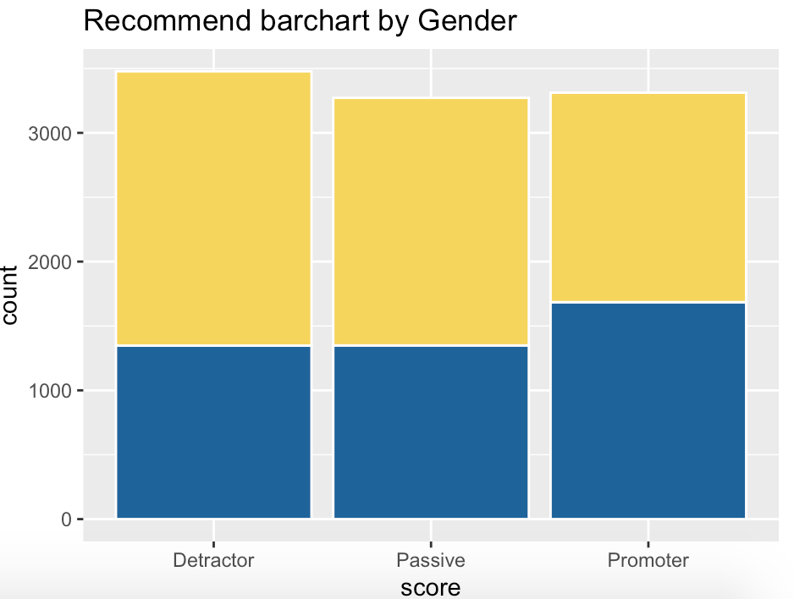
Gender
56.45%
43.55%
Notes:
In our dataset, we have 56 hundred observations coming from female and 43 hundred. So female takes roughly about 56% of our customer in this dataset. On the right you can see the barchart of type of customers with respect to gender. Where promoters seems evenly distributed among female and male, detractors and passive customers are taken mainly by females.

Slide 11
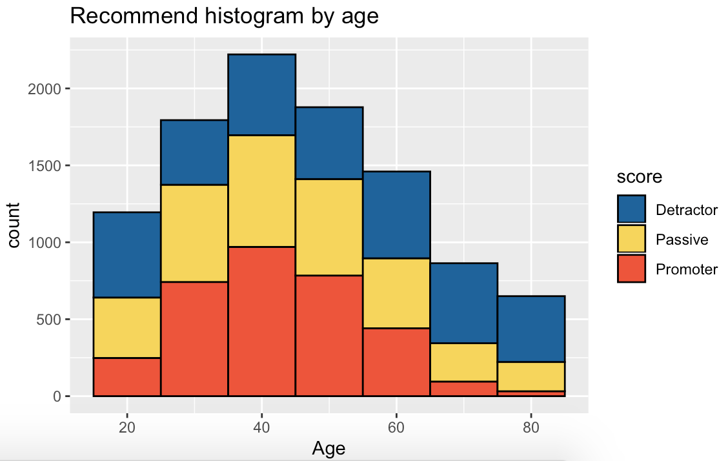
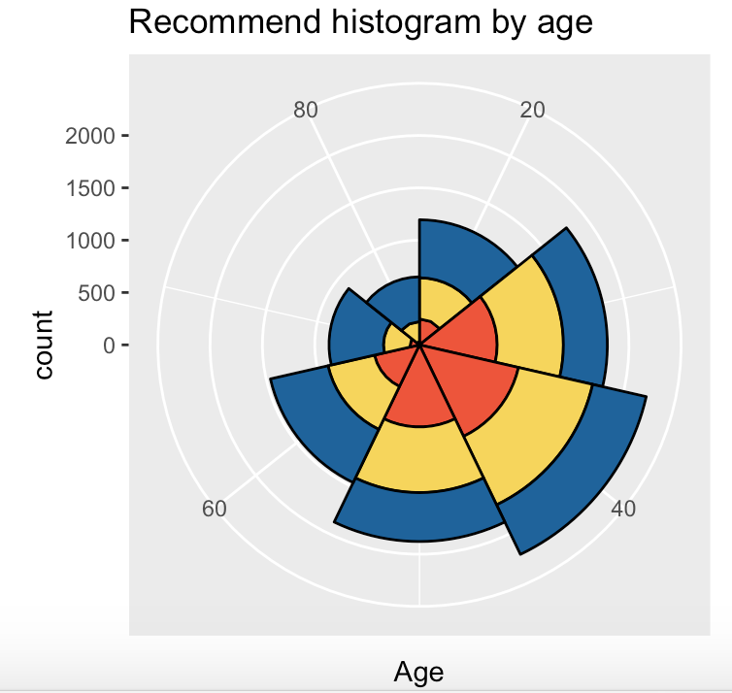
Age
Notes:
This histogram shows the number of customers in each level of satisfaction based on age. The plot shows that the happiest (most satisfied) customers are between the ages of 30-60 years old. We would need to improve the satisfaction for those under the age of 30 and those over the age of 60.

Slide 12
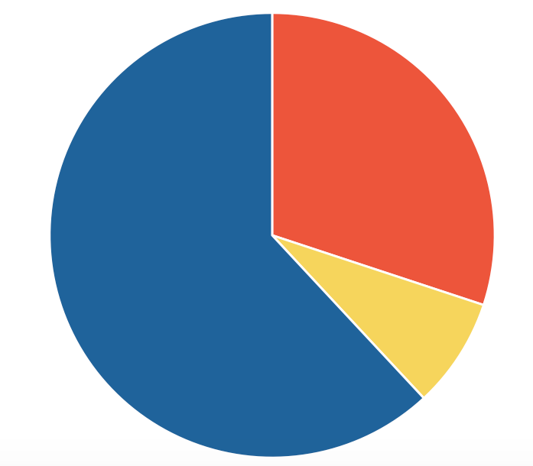
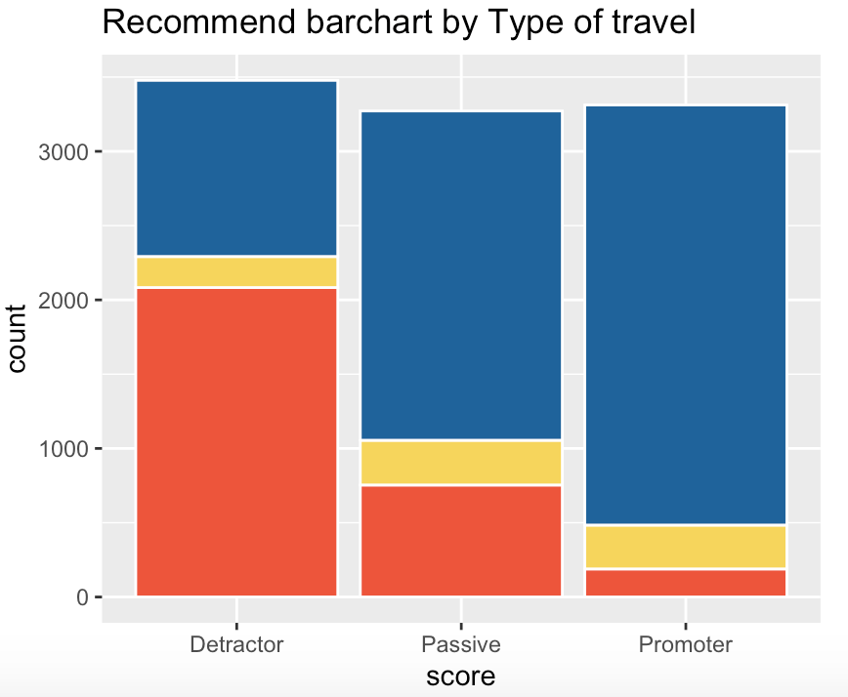
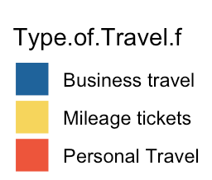
Type of Travel
30.07%
61.93%
8.00%
Notes:
In our dataset, the majority of type of travel is Business travel, which takes up to 61.93%, and then personal travel which is approximately 30%.
In the barchart on the right hand side, we can see the type of travel vs whether they are detractor, passive or promoter. Clearly we can see that, personal travellers tend to be detractors, while business travelers are mostly promoters and passive customers.

Slide 13
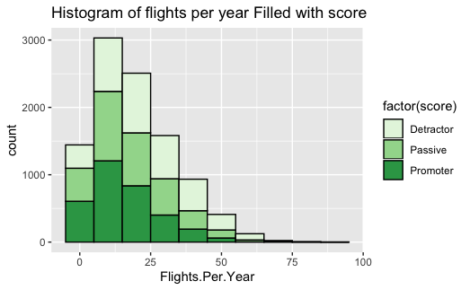
Flight per Year
Notes:
From the histogram above, we can clearly see that the relationship between customer’s reccomandation and their flights per year. We found that the percentage of promoter decreases as their flights increase. Maybe we can draw a conclusion that we should improve the service for those Who has flight more than 25-30 times per year.

Slide 14
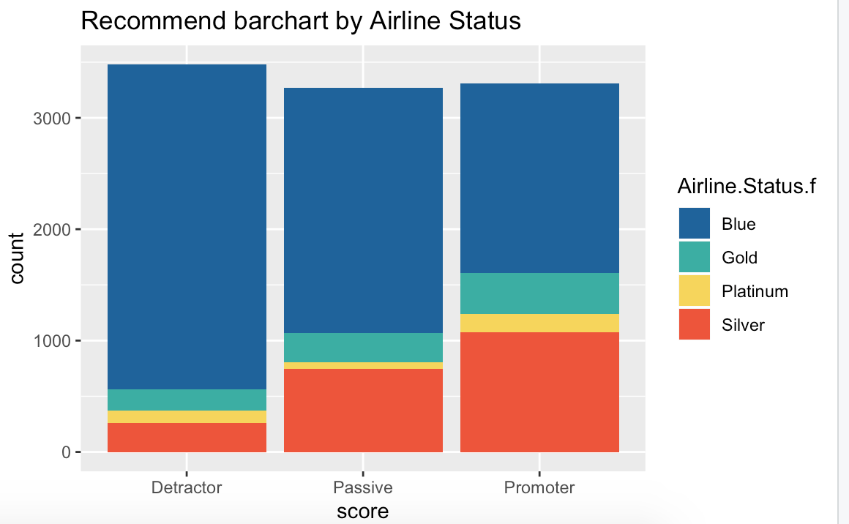
Airline Status
Blue
Silver
Gold
Platinum
Notes:
We also analysis the relationship between airline status and their recommendation. The status is devided into 4 classes. From low to high which ard blue sliver gold and platinum. From the Barchart we can see that the most Detractor are from Blue status. So we should focus more on blue stutas airlines.

Slide 15
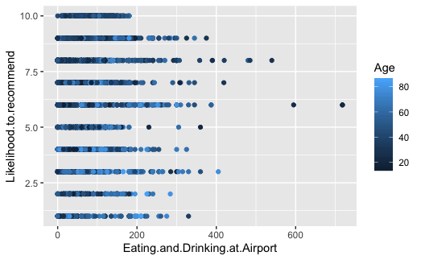
Eating and Drinking
Notes:
The last variable we analysis is eating and drinking at airport. We plot a scatter chart to illstrute the relationship. We can clearly see that the all people who tend to give 10 star spend less than 200 dollars. Next we are going to use several models to validate our hyposis.

Slide 16
Our Model
3
Models we built to evaluate customer satisfaction

Slide 17
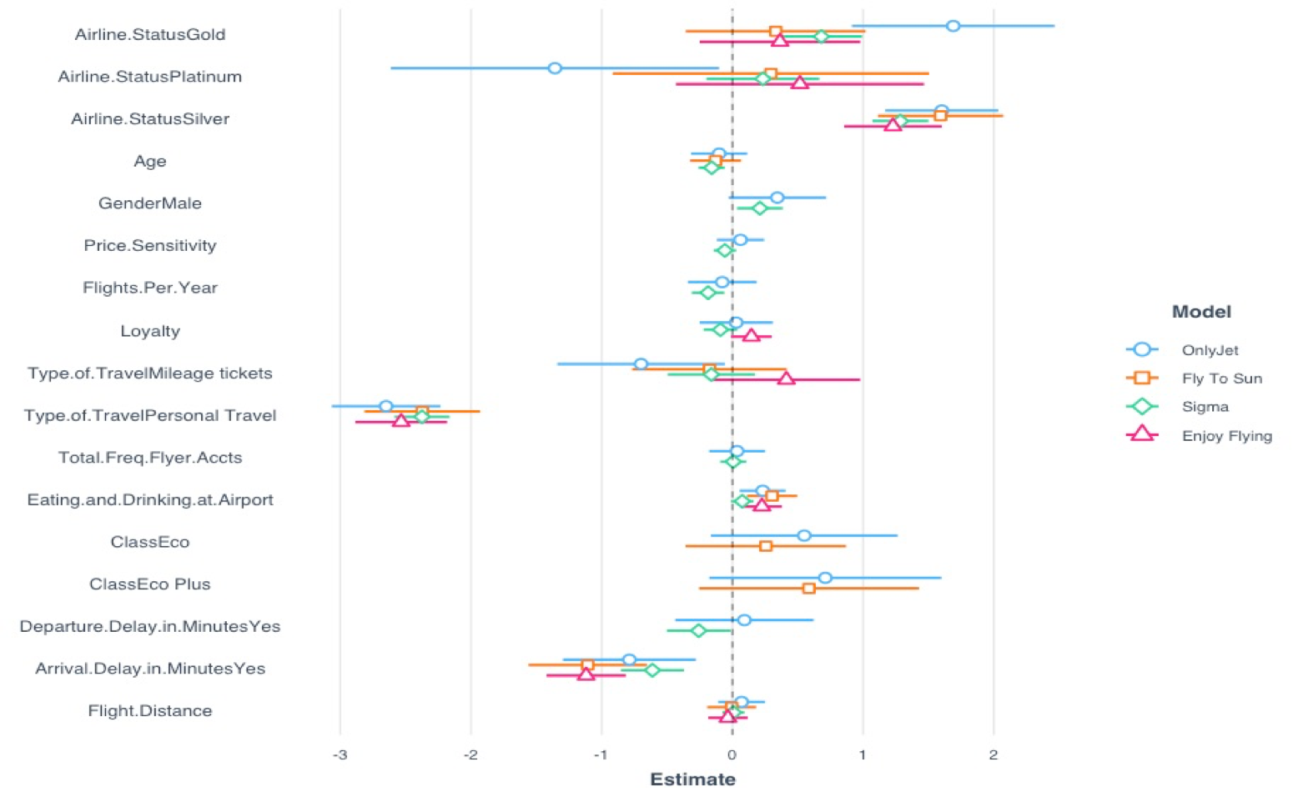
LINEAR MODEL
Notes:
We constructed linear model for different airlines. We choose 4 most typical and representative airlines to show. This plot is the coefficient of every variables for different airlines. We can see that some of coefficient for different airlines plays different role in models. For example, gold airlines status seems more important in Only Jet airlines for recommend grades. And platinum airlines status seems have negative influence for recommend grades compare with other three airlines. Those information are so important that if we want perform different market strategy for different airlines, for example The Only Jet Airline may need more focus on gold airline status people than other airlines.

Slide 18
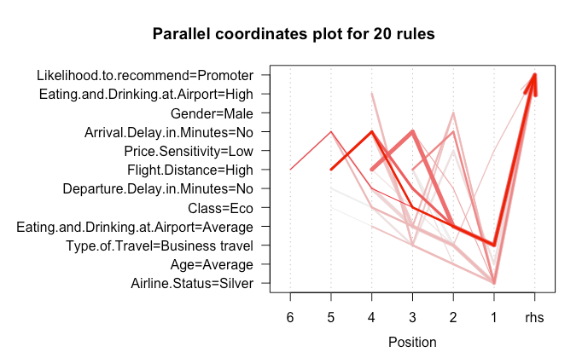

ASSOCIATION RULE MINING
Characteristics of a Promoter:
Long distance flights
No Arrival Delay
Economic Class
Average amount spent on food at Airport
Business Travel
PROMOTERS
Notes:
We ran association rules to find the probability of relationships between data items.
I will be talking about promoters and detractors.
Based on the plot we can infer what are the characteristics of promoter
Based on the plot we can infer what are the characteristics of detractor

Slide 19
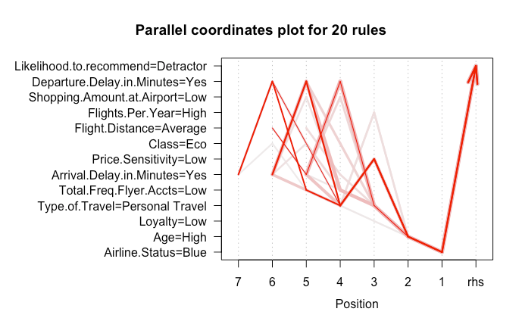

ASSOCIATION RULE MINING
Characteristics of Detractors:
Elder Age
Personal Travel
Blue Status
Has Departure Delay
Has Arrival Delay
Low Price Sensitivity
Low Frequent Flyer Accounts
DETRACTORS

Slide 20
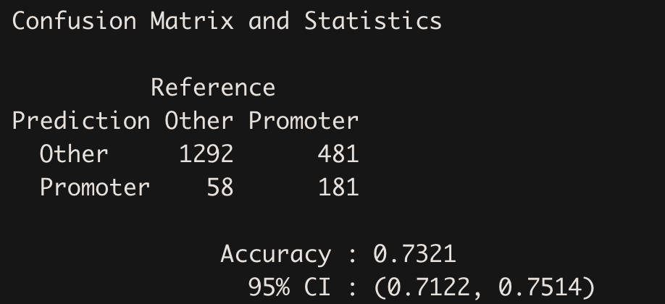
Logistic Regression Model
Accuracy: 73.21%
Significant variables according Model:
Age, Price Sensitivity, Flights per Year, Arrival Delay, Gender, Airline Status, Type of Travel, Airline Partners.
Notes:
This model we think is best than other one so far. The reason why we choose logistic Regression model than others. Firstly, it can give us a decent accuracy about whether a person is promotor or not. The second reason is that based on the model, we can know which variables is more important and its weight for improve recommend score. The whole model is clear and relevant simple, it's great to analysis variables. According to model, we have age, ...., those variables basically matched with variables we have discussed. That proves our idea is correct.

Slide 21
Insight & Strategy
4
Services & Customer Perks

Slide 22
Services
Airport Services:
Adding some extra facilities to improve safe and comfortable travel for senior citizens and assisting them with baggage and boarding the flight.
Inflight Services:
Improving or updating the quality of in-flight entertainment systems in all airlines.
Airline Services:
Improving the standard of services in the blue status airlines may lead to an increase in the satisfaction.
Notes:
Based on our analysis we have some suggestions that we believe could help with overall customer experience

Slide 23
Customer Perks
Type of Travel:
Introducing promotional offers to customers on personal travel.
Flight Delays:
In case of flight cancellation or long delays, airlines should provide appropriate compensation such as accommodation, rescheduling etc.
Notes:
Introducing promotional offers to customers on personal travel to bridge the gap of services offered in other cases. Will help in boosting satisfaction.

Slide 24
THANKS!
Any questions?

